Slide 1
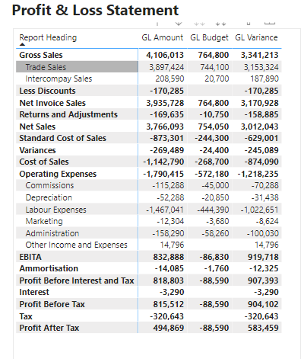

Financial Modelling with Power BI
Bob Duffy, MVP, MCM, MCA

Slide 2

Bob Duffy
30 years in database sector, 250+ projects
SQL Server MCA, MCM, MVP
SSAS Maestro
Senior Data Platform Consultant with Microsoft 2005-2008
Database Architect at Prodata SQL Centre of Excellence
http://blogs.prodata.ie/author/bob.aspx
bob@prodata.ie

Slide 3
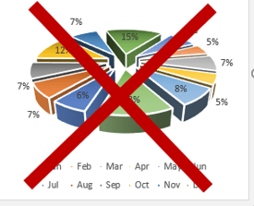
Agenda
What is Financial Reporting/Modelling
Seven Challenges for Financial Reports (GL)
Chart of Accounts
Debit/Credits (Sign Inversion)
Ragged Hierarchies
Proforma Layout
Custom Operators (and M2M!)
Report Versioning
Empowering Excel Users
No Fancy DataViz Here ! (Just Pro Forma Data)

Slide 4
What is Financial Reporting
Finance is typically split into a few modules
GL – General Ledger
AP – Accounts Payable
AR – Accounts Receivable
Stock – Stock Valuation, Price variation
We will focus on General Ledger
The Holy Trinity of GL Reporting
P&L – Profit and Loss (aka Income Statement)
BS – Balance Sheet
CF – Cash Flow

Slide 5
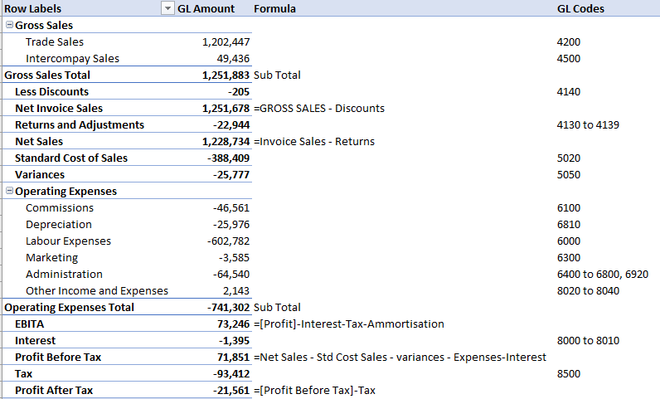
7 P&L Challenges
* A Typical Requirements Spec for P&L*
Chart of Accounts
Debit/Credits (Sign Inversion)
Ragged Hierarchies
Proforma Layout
Custom Operators and Meta Data
Report Versioning
Empowering Excel Users

Slide 6
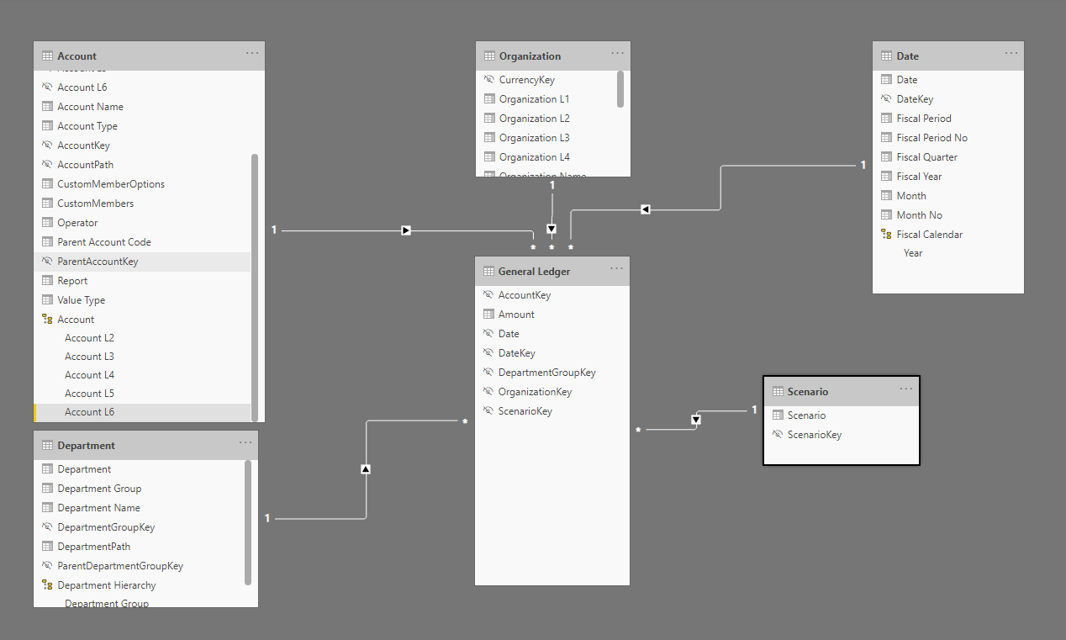
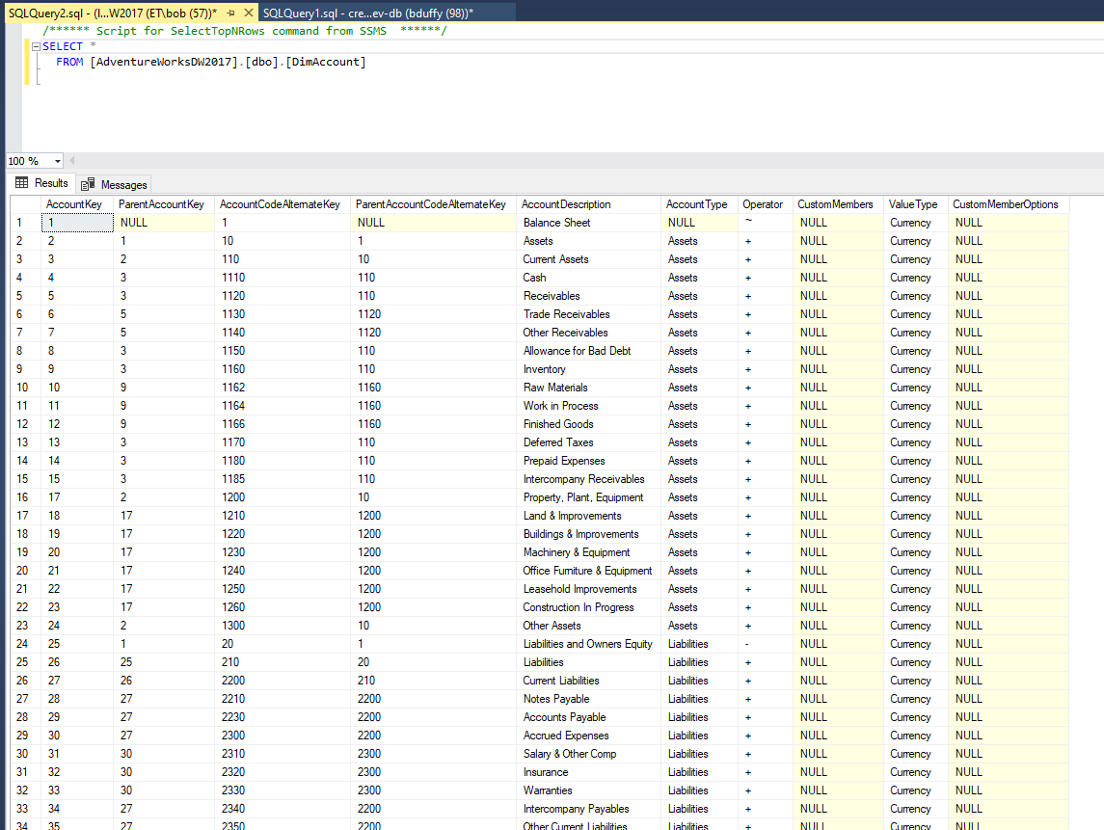
The Chart of Accounts
The Most import is the Chart of Accounts which defines the type measure (Sales, Cost, Wages, etc)
May also have a way to determine how each entry is expense (+) or liability (-)
Can be Parent Child. Usually “range based” rollup for large organizations (Think of it like IP4 allocations)
Notes:
Missing Cost Centre

Slide 7
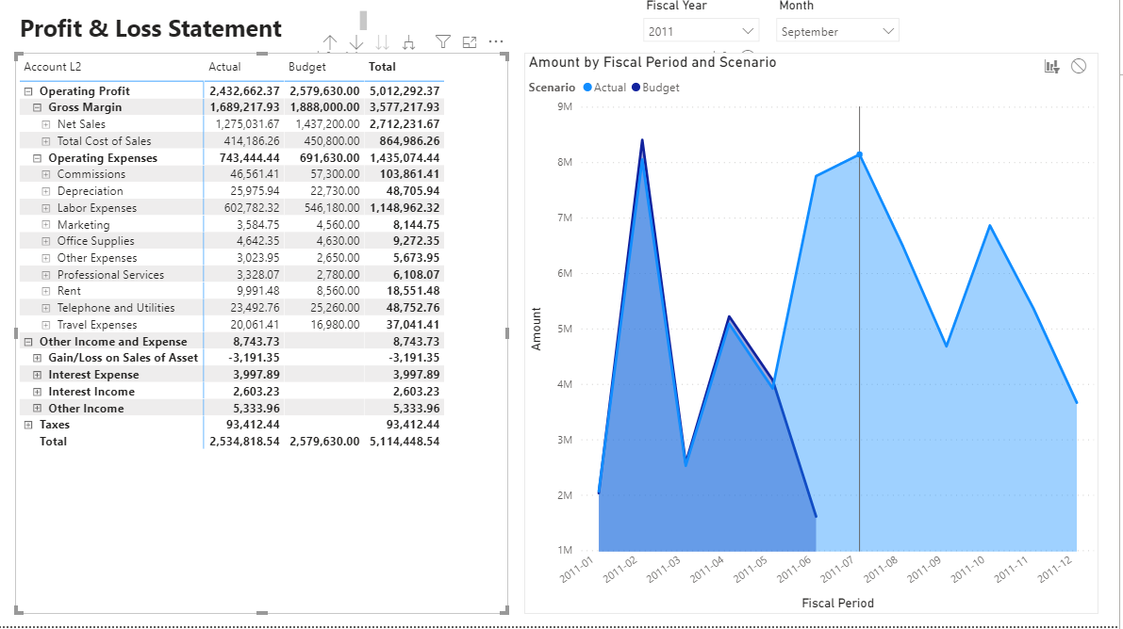
Basic Model with Parent/Child
Bring it in “as is” in Matrix View
Use PATH functions to deal with Hierarchies
PATH, PATHLENGTH, PATHITEM, LOOKUP
Demo
Notes:
Missing Cost Centre

Slide 8
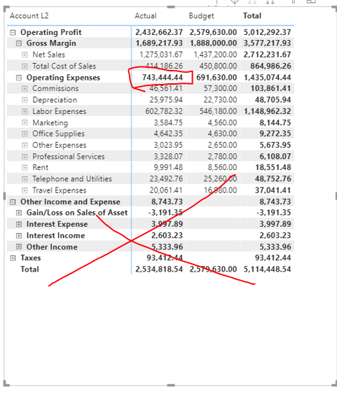
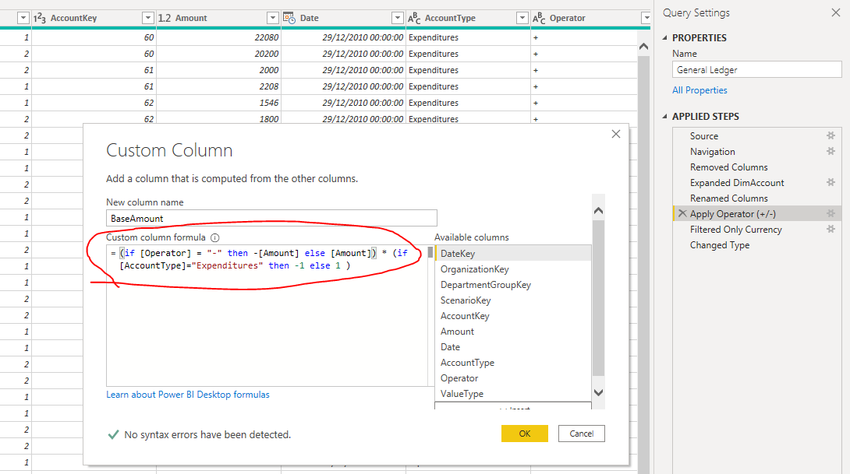
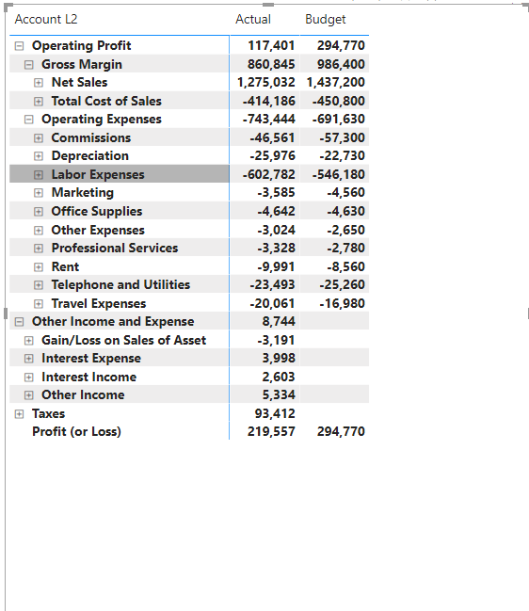

Dealing with Signage and Credit/Debit
Either convert in DAX or at ETL time
Demo
Notes:
Bonus for Adding Total

Slide 9
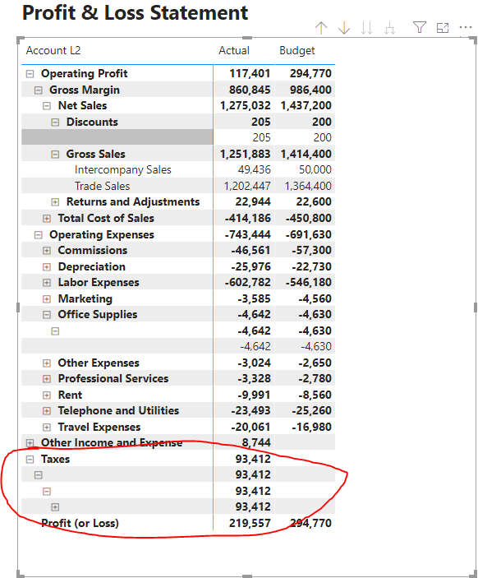
Dealing with Ragged Hierarchies
Demo
https://www.daxpatterns.com/parent-child-hierarchies/#
Notes:
Missing Cost Centre

Slide 10
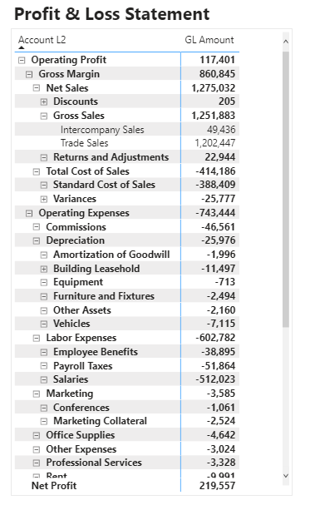
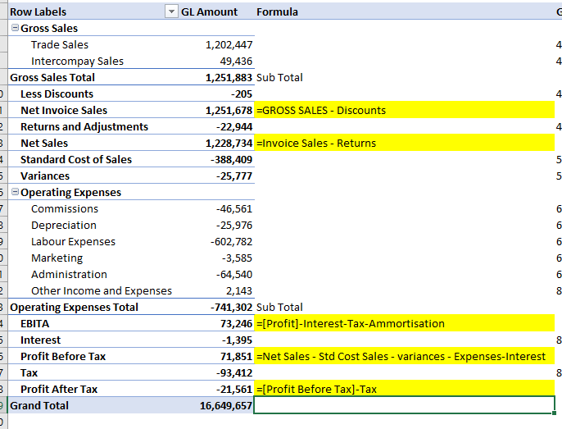
Pro Forma Layout Calculated Members
How do we do this. A few options
Calculation Groups / SCOPE for calculated members
Some Different Thinking on Data Model (next slide)
Notes:
Missing Cost Centre

Slide 11
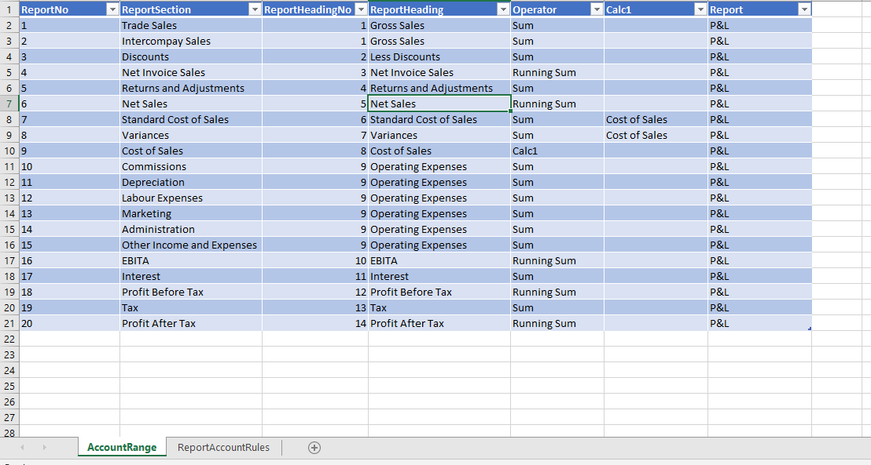
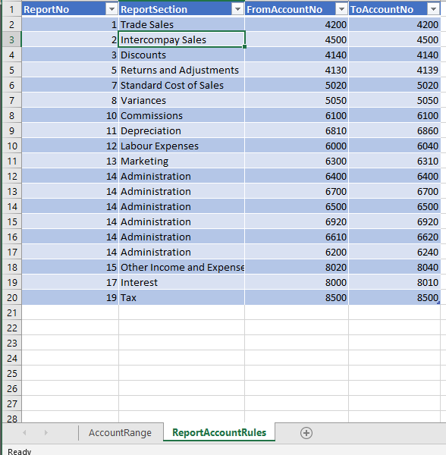
Converting running Sum into a M2M table
Less DAX more modelling ;-)
Notes:
Missing Cost Centre

Slide 12
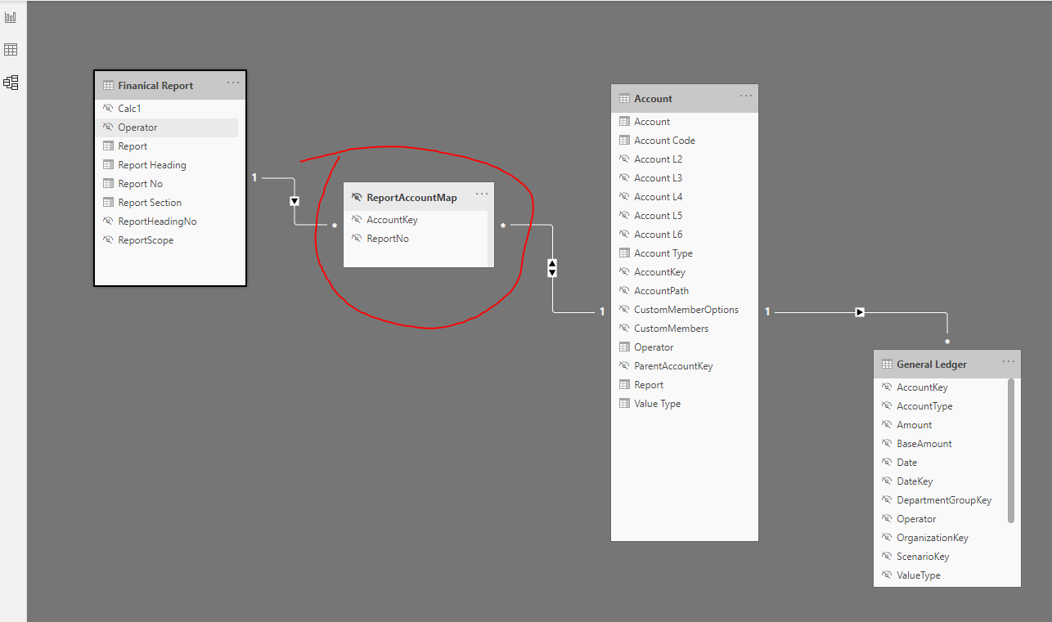
The Final M2M Model
Notes:
Missing Cost Centre

Slide 13
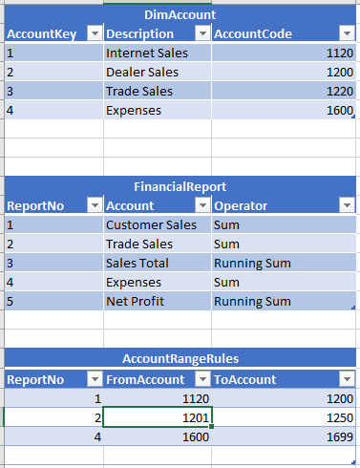
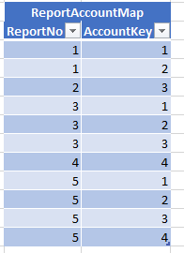
The Final M2M Table – How to create it?
Demo
Notes:
Missing Cost Centre

Slide 14
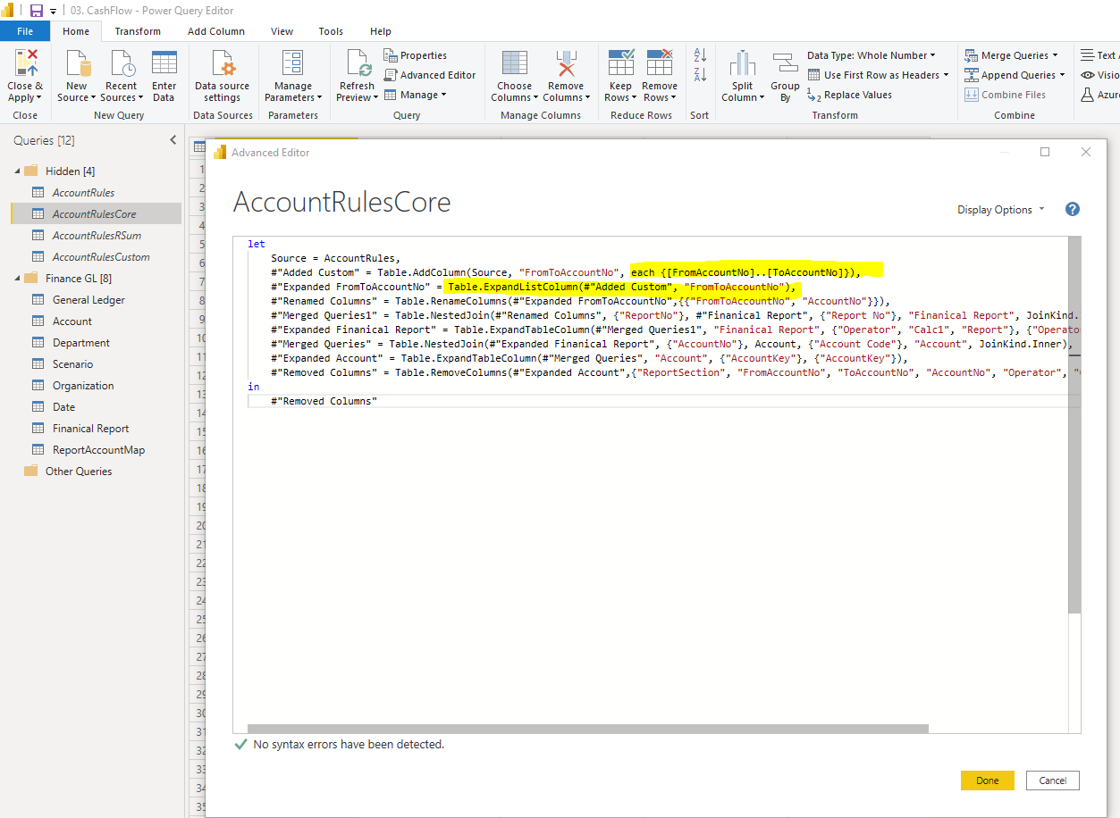
How to code ReportAccountMap (Power BI)
Demo

Slide 15
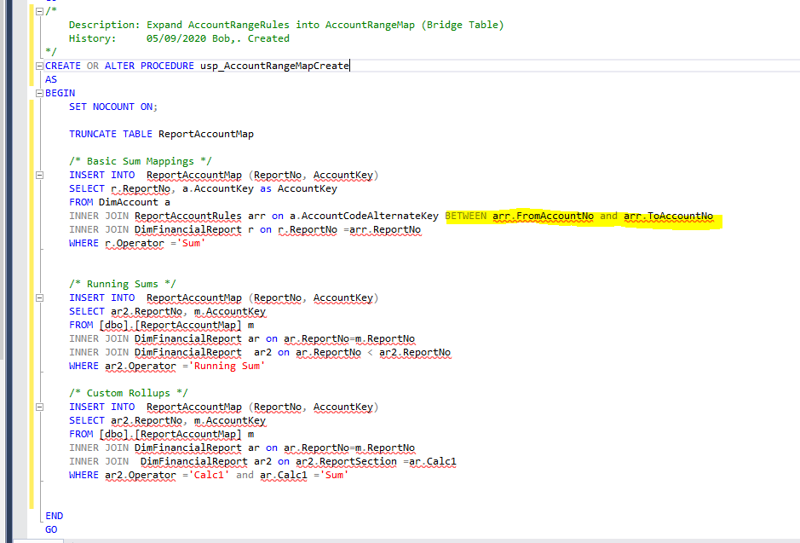
How to code ReportAccountMap (TSQL)

Slide 16
Budgets
Measure | DAX
GL Budget | GL Budget = VAR s = SELECTEDVALUE ( Scenario[Scenario], "Budget" ) RETURN CALCULATE ( SUM ( 'General Ledger'[BaseAmount] ), Scenario[Scenario] = s ) * 'Finanical Report'[ReportScope]
GL Actual | GL Amount = VAR s = SELECTEDVALUE ( Scenario[Scenario], "Actual" ) RETURN CALCULATE ( SUM ( 'General Ledger'[BaseAmount] ), Scenario[Scenario] = s ) * 'Finanical Report'[ReportScope]
Demo
Notes:
Missing Cost Centre

Slide 17
Opening and Closing Balance for Balance Sheet
Measure | DAX
Opening Balance | VAR MinPeriod = MIN ( 'Date'[Fiscal Period No] ) RETURN CALCULATE ( [GL Amount], ALL ( 'Date' ), 'Date'[Fiscal Period No] < MinPeriod )
Closing Balance | VAR MaxPeriod = MAX ( 'Date'[Fiscal Period No] ) RETURN CALCULATE ( [GL Amount], ALL ( 'Date' ), 'Date'[Fiscal Period No] <= MaxPeriod )
Movement | Closing Balance – Opening Balance
Demo
Notes:
Missing Cost Centre

Slide 18
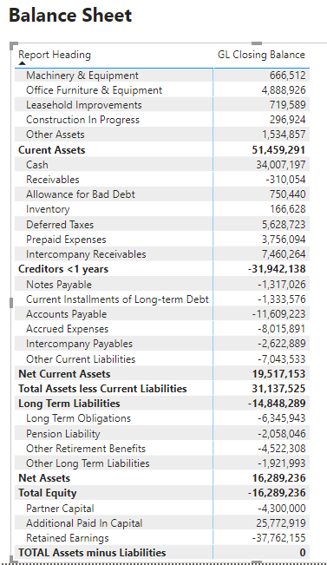
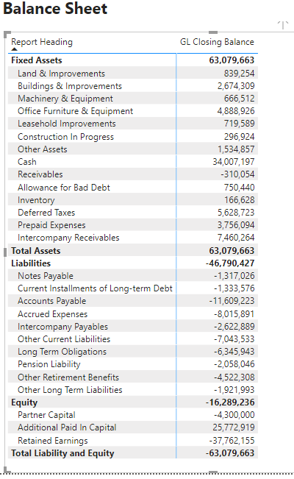
Report Versioning
Demo
Notes:
Missing Cost Centre

Slide 19
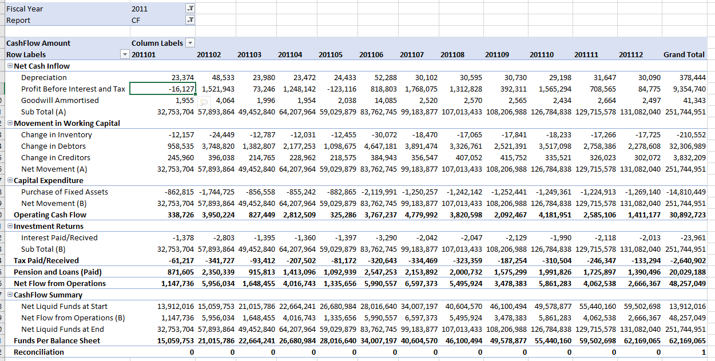
Empowering Excel
Demo

Slide 20

Summary – Why use Meta Data Driven Reports ?
Less DAX means faster/flexible model
Change report layouts “outside” of PowerBI
Custom Operators and Aggregations
Support multiple reports and report versioning
Less DAX More Modelling ;-)

Slide 21
Thank You
Any Q+ A

Slide 22
Supporting Blogs
Sample Financial Reports for AdventureWorks (Updated)
https://github.com/ProdataSQL/FinancialModelling
Why Chart of Accounts doesn’t work for Financial Reporting http://blogs.prodata.ie/post/Why-Chart-of-Accounts-doesnt-work-for-Financial-Reporting.aspx
Using Many to Many for Financial Reporting http://blogs.prodata.ie/post/Using-Many-to-Many-for-Financial-Reporting.aspx
Using Many to Many for Running Sum
http://blogs.prodata.ie/post/Using-Many-to-Many-for-Running-Sum.aspx

Slide 23
CF – Cash Flow

Slide 24
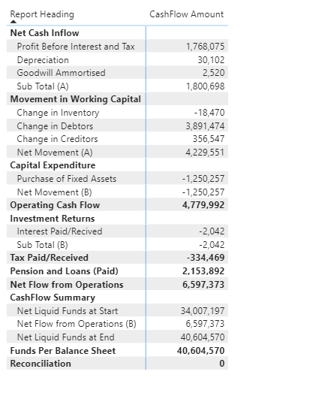
What’s Different About Cashflow
Takes Profit form PL
Deducts non cash elements
Adds Cash Movement from BS
May have reconciliation
Demo

Slide 25
What’s Different About Cashflow
Takes Profit from PL
Deducts non cash elements
Adds Cash Movement from BS
May have reconciliation
Demo

